Slide 1
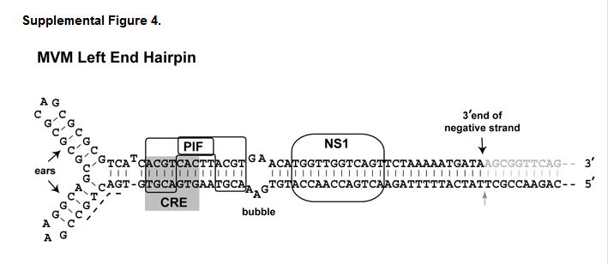
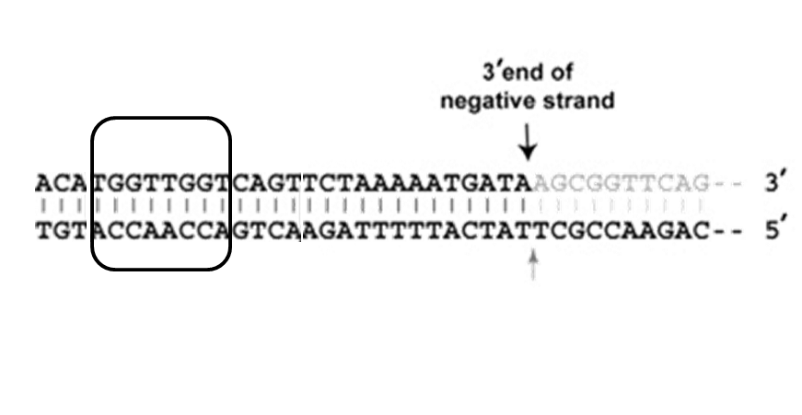

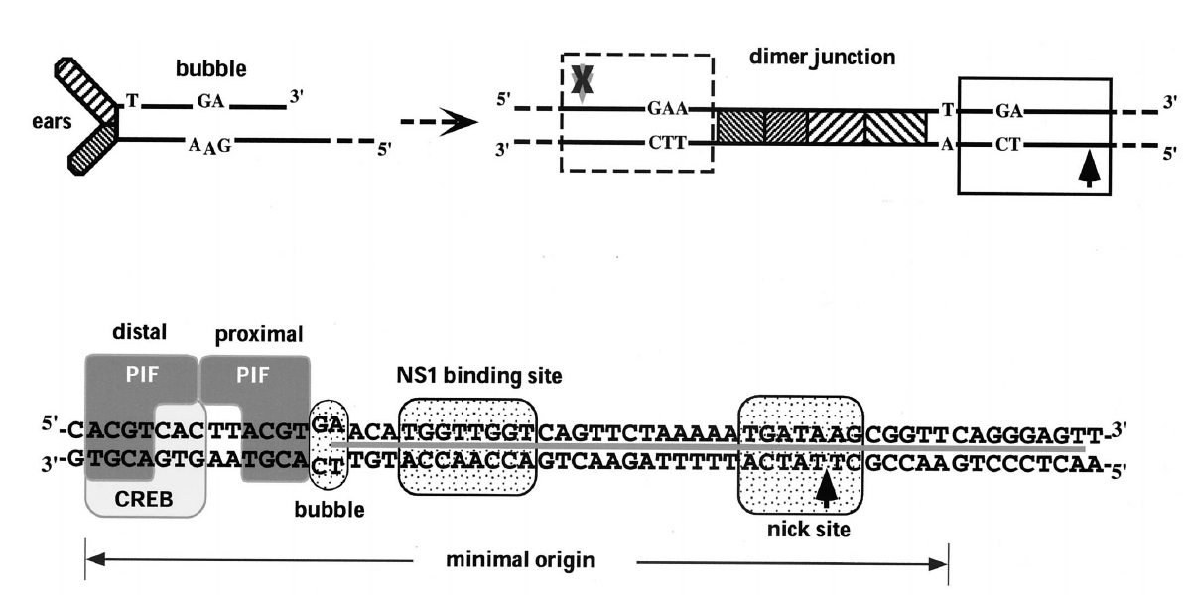
3’ end of
negative strand
*
NS1
5’
3’
3’
5’
bubble
nick site
minimal origin

Slide 2


Slide 3

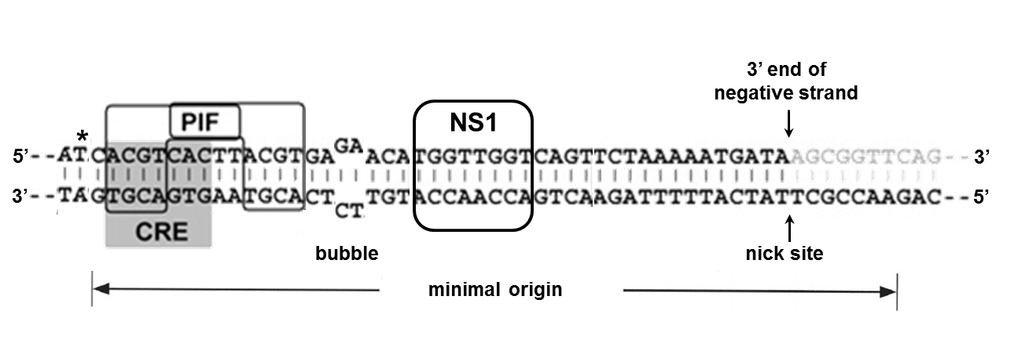
dimer junction
big ear
inboard arm
outboard arm
bubble
little ear
big ear
little ear

Slide 4
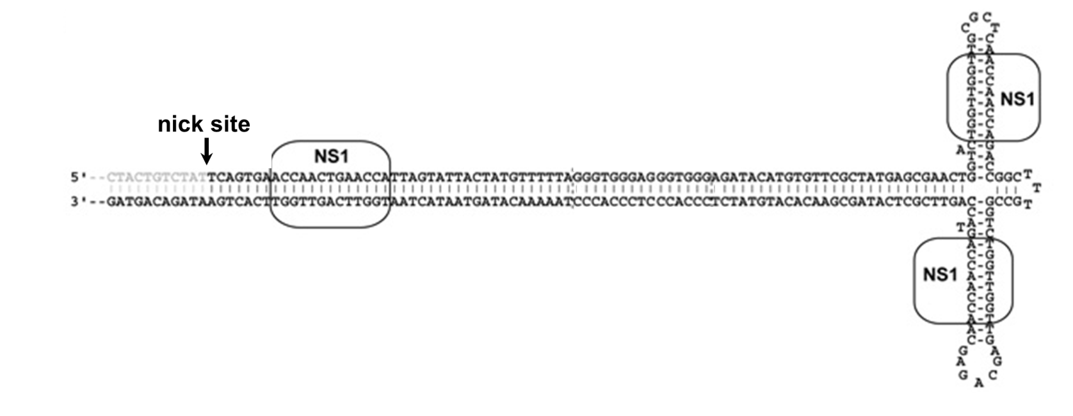

Slide 5


Slide 6
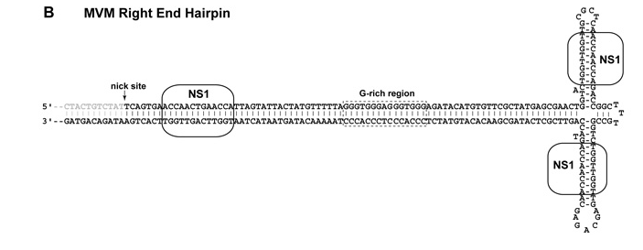
nick site

Slide 7

P4
P38

